Slide 1
INVESTMENT ASSIGNMENT SUBMISSION
Name: Rahul Goyal

Slide 2
Spark Funds wants to understand the global trends in investments so that investment decisions can be taken.
Constraints for investments:
a. It wants to invest between 5 to 15 million USD per round of investment
b. It wants to invest only in English-speaking countries because of the ease of communication with the companies it would invest in.
Strategy:
Based on data first identify the funding type, after that country (english speaking) to invest and finally, sector to invest.

Slide 3
Methodology
1. Data Cleaning to remove incorrect values.
2. Merging of companies, investment round and sector mapping data.
3. Identify the representative funding amount to invest from data set.
4. Identify the representative amount of all the funding type. Based on the data select the funding type.
5. Identify three English speaking countries where most investment has happened for that funding type.
6. Identify the sector to invest in the identified country.

Slide 4
1. More than 50 percent companies has invested as “Venture” investment type.
2.The representative amount of “Venture” is 5 million dollars which is between 3 and 15 million USD.
3. Top English speaking countries are USA, GBR and IND
4. Top sectors in all the three countries
a. USA - Cleantech / Semiconductors, Others and Social, Finance, Analytics, Advertising
b. GBR - Cleantech / Semiconductors, Others and Social, Finance, Analytics, Advertising
c. IND - News, Search and Messaging, Others and Social, Finance, Analytics, Advertising

Slide 5
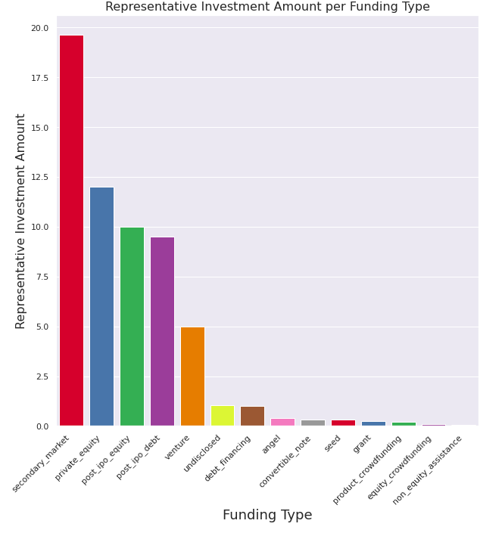
Representative Investment Amount per Funding Type

Slide 6
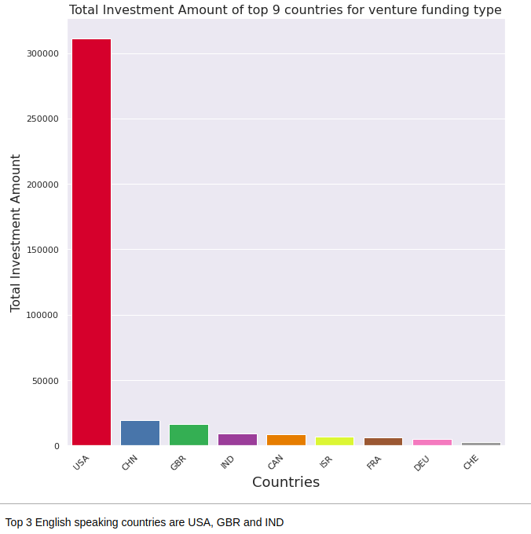
Top nine countries with most investments

Slide 7
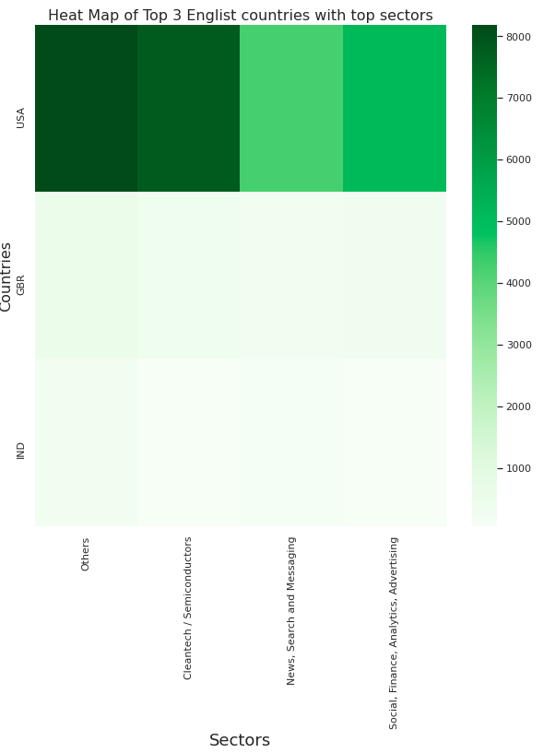
Top sectors to invest in the Countries.

Slide 8
Conclusion
1. Money to invest – 5 Million
2. Country to invest – USA
3. Sector to invest - Cleantech / Semiconductors
*As others sector contains multiple undefined sectors.

